Slide 1
REFERENCE CIRCUITS
A reference circuit is an independent voltage or current source which has a high degree of precision and stability.
  Output voltage/current should be independent of power supply.
  Output voltage/current should be independent of temperature.
  Output voltage/current should be independent of processing variations.

Slide 2
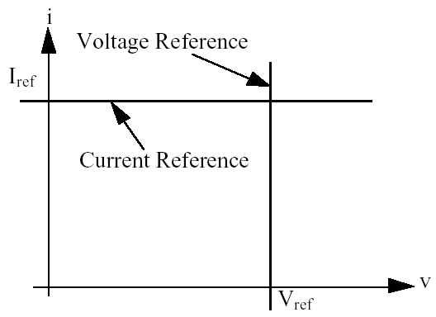
I-V curves of ideal references

Slide 3
Types of commonly used references
Voltage dividers - passive and active.
MOS diode reference.
PN junction diode reference.
Gate-source threshold reference circuit.
Base-emitter reference circuit.
Thermo voltage reference circuit
Bandgap reference circuit

Slide 4
Typical variations affecting the references
Power supply variation (main concern here)
Load variation (r_{o}=∞ for I-ref, r_{o}=0 for V-ref)
Temperature variation (main concern also)
Processes variation (good process and layout)
Interferences and noise (not considered here)

Slide 5
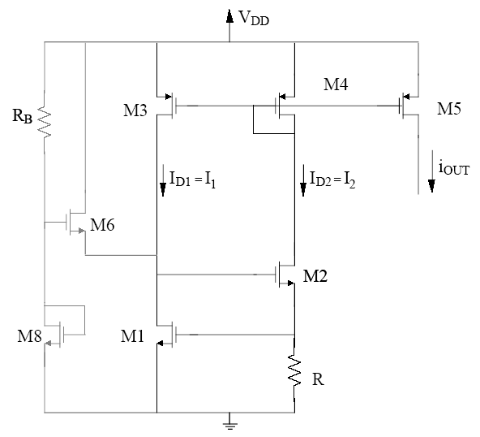
V_{GS} based Current reference
MOS version: use V_{GS} to generate a current and then use negative feed back stabilize i in MOS
Start
up
Current mirror
V_{GS}

Slide 6
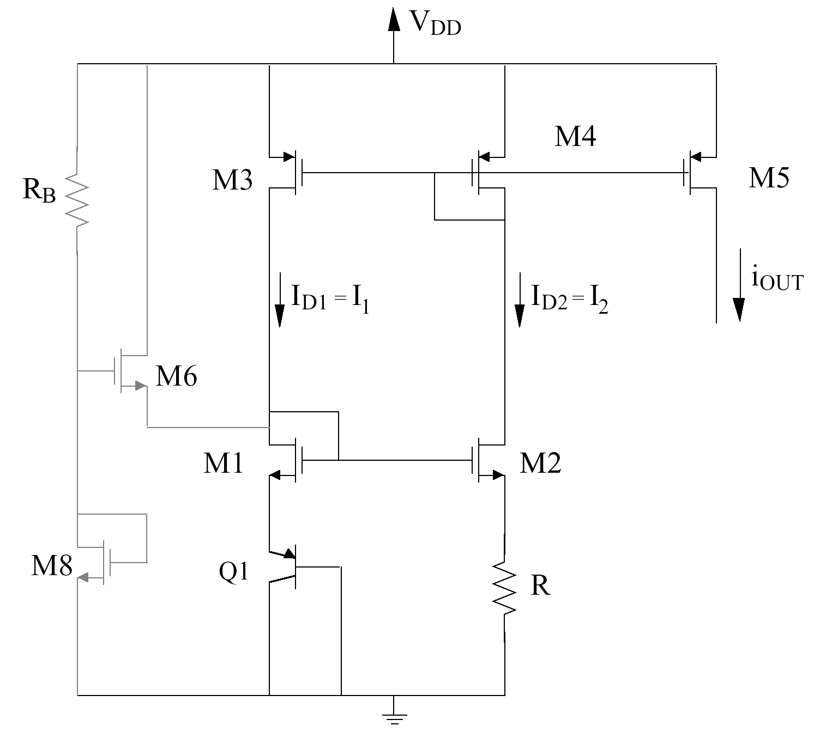

V_{EB} based current reference
Start
up
V_{EB}=V_{R}
Negative temp
coefficient

Slide 7
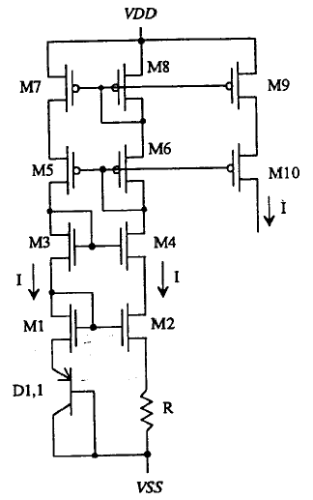
A cascoded version to increase r_{o} and reduce sensitivity:
Requires start up
Not shown here
V_{EB} reference

Slide 8
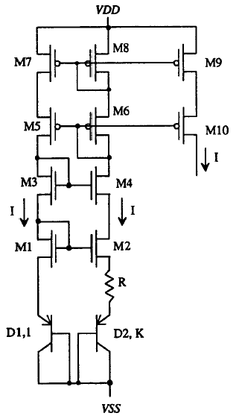
A thermal voltage based current reference
Current mirror
I₁ = I₂, ⇒ J₁ = KJ₂,
but J = J_{s}exp(V_{EB}/V_{t})
⇒ J₁/J₂ = K =
exp((V_{EB1}─ V_{EB2})/V_{t})
⇒ V_{EB1}─ V_{EB2} = V_{t} ln(K)
⇒I = (V_{EB1}─ V_{EB2})/R
= V_{t} ln(K)/R ∝ V_{t} = kT/q
J1
J2
PTAT

Slide 9
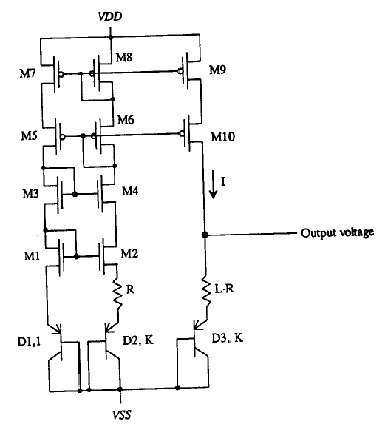
A band gap voltage reference
V_{out} = V_{EB3} + I*L*R = V_{EB3} + (kT/q)*Lln(K)
∂V_{out}/∂T = ∂V_{EB3}/∂T + (k/q)*Lln(K)
At room temperature, ∂V_{EB3}/∂T = ─2.2 mV/ºC,
k/q = +0.085 mV/ºC.
Hence, choosing appropriate L and K can make
∂V_{out}/∂T=0
When this happens, V_{out} = 1.26 V
PTAT
PTAT
Negative temp
coefficient

Slide 10
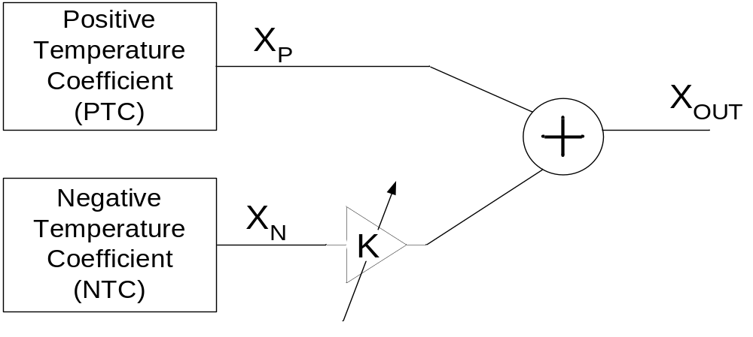
General principle of bandgap reference
Generate a negatively PTAT (Proportional To Absolute Temperature) and a positively PTAT voltages and sum them appropriately.

Slide 11
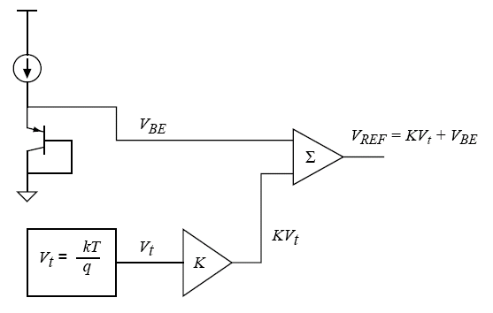
A Common way of bandgap reference

Slide 12
V_{BE} is negatively PTAT at roughly -2.2 mV/°C at room temperature, called CTAT
V_{t} (V_{t} = kT/q) is PTAT that has a temperature coefficient of +0.085 mV/°C at room temperature.
Multiply V_{t} by a constant K and sum it with the V_{BE} to get
V_{REF} = V_{BE} + KV_{t}
If K is right, temperature coefficient can be zero.

Slide 13
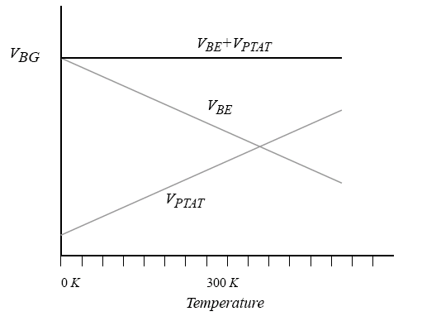
In general, use V_{BE} + V_{PTAT}

Slide 14
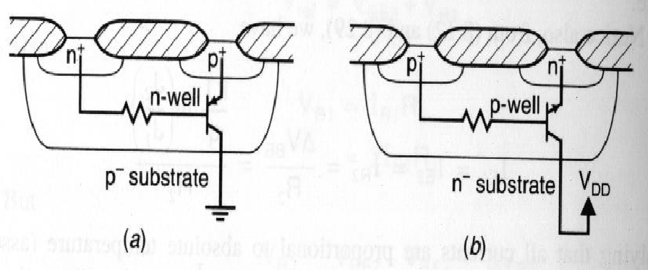
How to get Bipolar in CMOS?

Slide 15
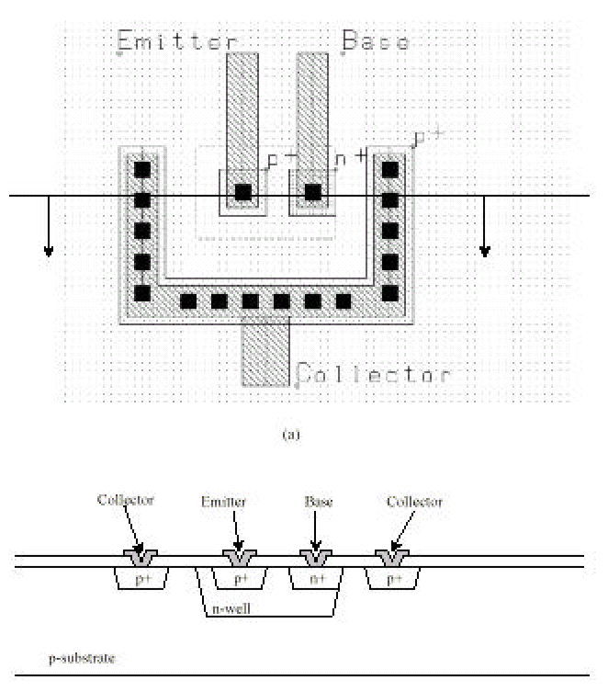

Slide 16
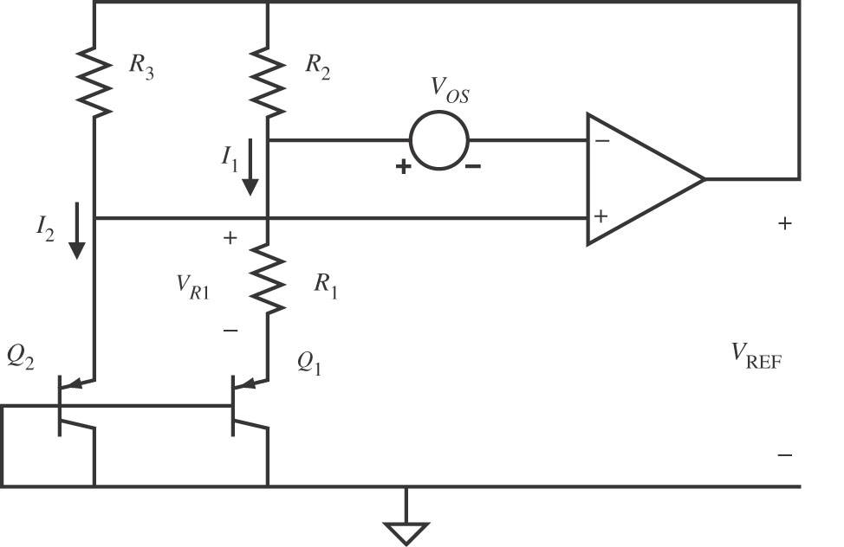
A conventional CMOS bandgap reference for a n-well process

Slide 17





V_{OS} represents input offset voltage of the amplifier.
Transistors Q₁ and Q₂ are assumed to have emitter-base areas of A_{E1} and A_{E2}, respectively.
If V_{OS} is zero, then the voltage across R₁ is given as

Slide 18
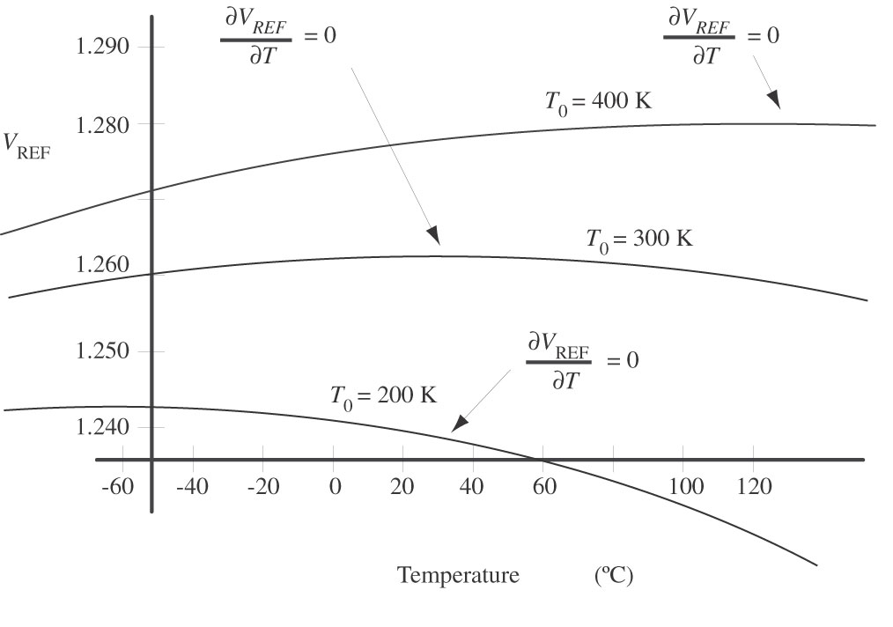
Bandgap reference still varies a little with temp

Slide 19
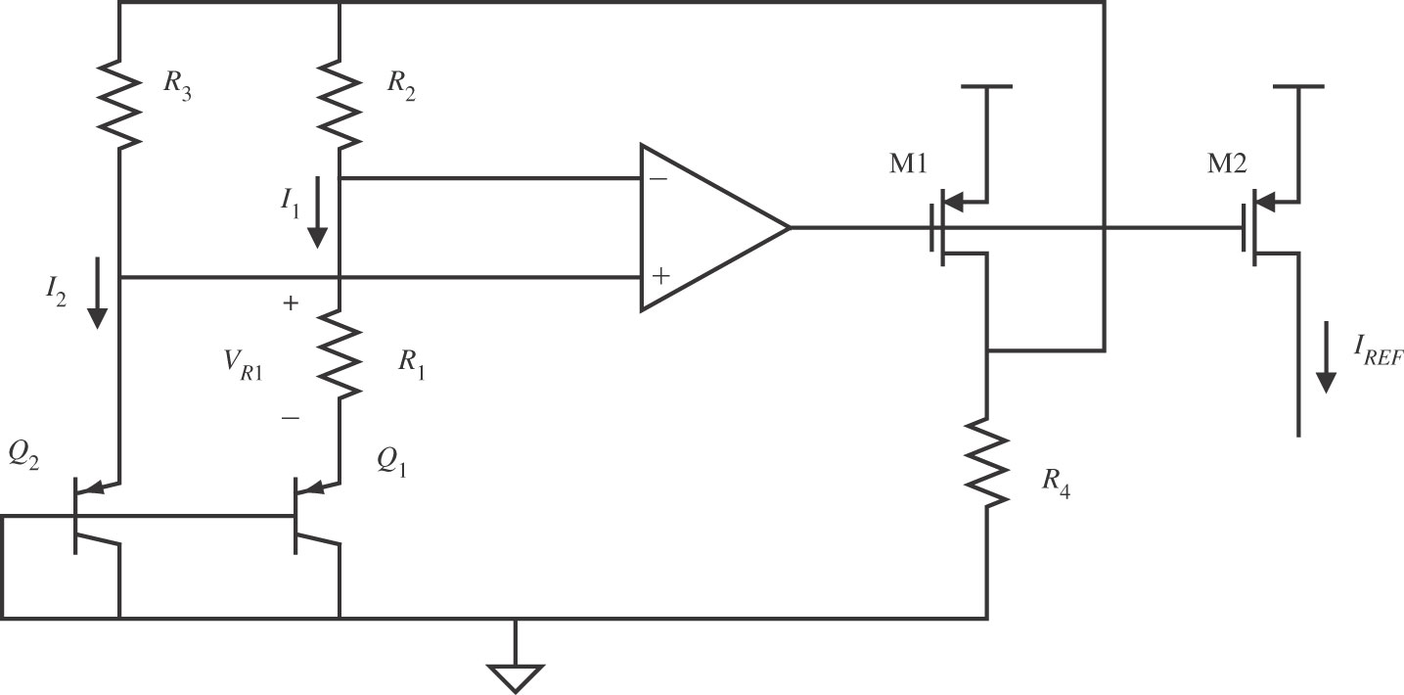
Converting a bandgap voltage reference to a current reference

Slide 20
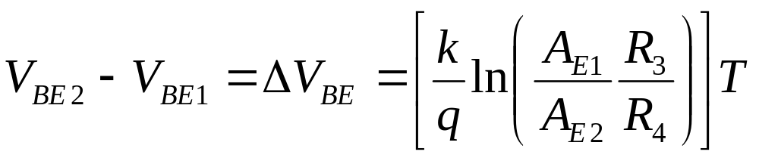
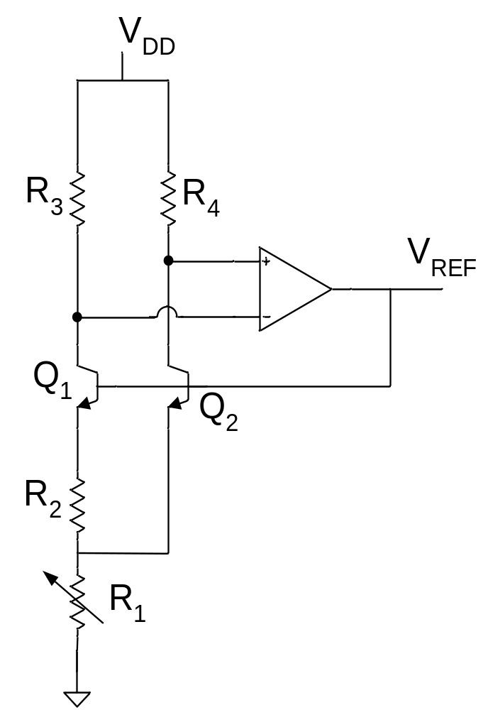
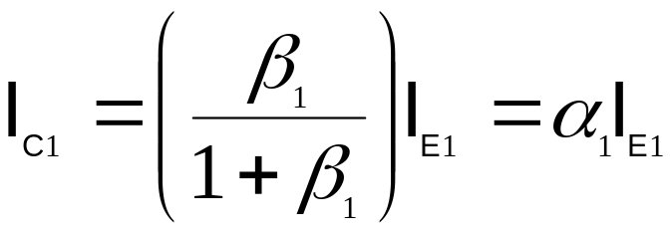
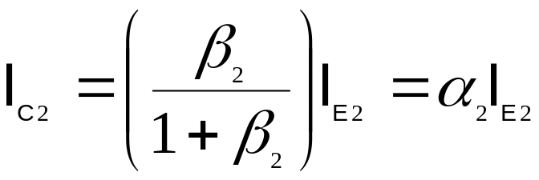
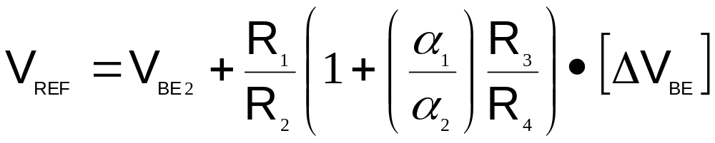

Slide 21
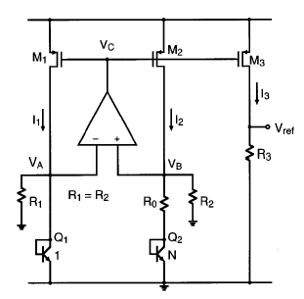
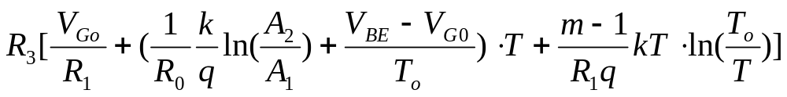
Vref=I₃*R₃=

Slide 22
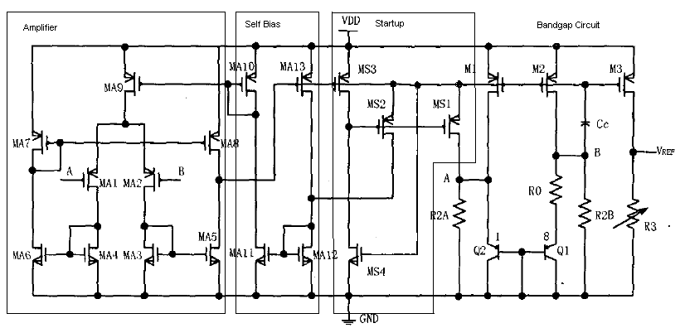
Bandgap circuit formed by transistors M1, M2, M3, Q1, Q2, resistors R0, R2A, R2B, and R3.
Cc is inter-stage compensation capacitor. Think of M2 as the second stage of your two stage amplifier, then Cc is connected between output B and the input Vc.

Slide 23
Amplifier: MA1~MA9, MA9 is the tail current source, MA1 and MA2 consistent of the differential input pair of the op amp, MA3~MA6 form the current mirrors in the amplifier, MA7 converts the amplifier output to single ended, and MA5 and MA8 form the push pull output node.
  The offset voltage of the amplifier is critical factor, ➔use large size differential input pair and careful layout; and use current mirror amplifier to reduce systematic offset.
  2V supple voltage is sufficient to make sure that all the transistors in the amplifier work in saturation.
  PMOS input differential pair is used because the input common mode range (A,B nodes) is changing approximately from 0.8 to 0.6 V and in this case NMOS input pair won’t work.
Self Bias: MA10~MA13, a self-bias approach is used in this circuit to bias the amplifier. Bias voltage for the primary stage current source MA13 is provided by the output of the amplifier, i.e. there forms a self-feedback access from MA8 drain output to bias current source MA9 through current mirror MA10~MA13.
Startup Circuit: MS1~MS4. When the output of the amplifier is close to Vdd, the circuit will not work without the start-up circuit. With the start-up circuit MS1 and MS2 will conduct current into the BG circuit and the amplifier respectively.

Slide 24
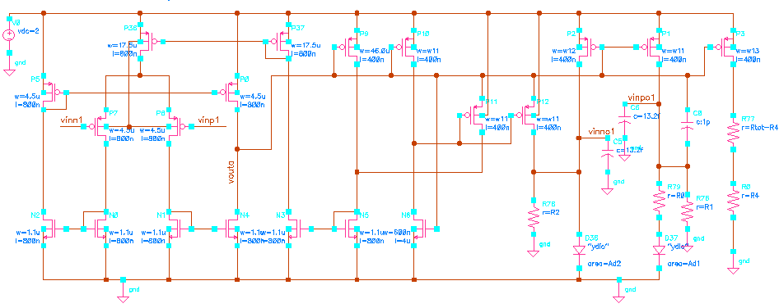
Cc is 1 pF
To have better mirror accuracy, M3 is driving a constant resistor Rtot.
Capacitors at nodes A and B are added.

Slide 25
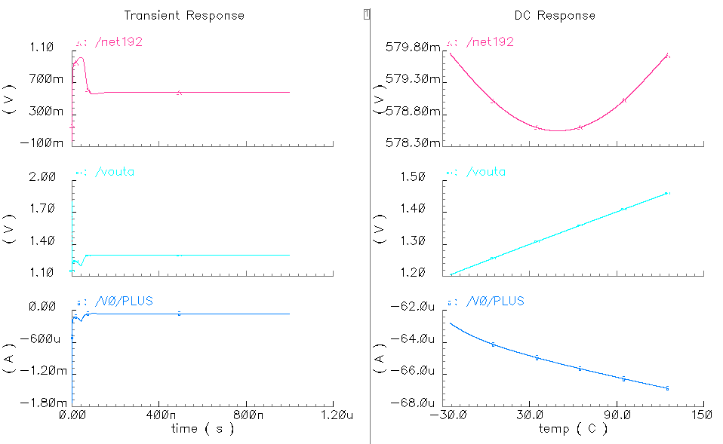

Slide 26
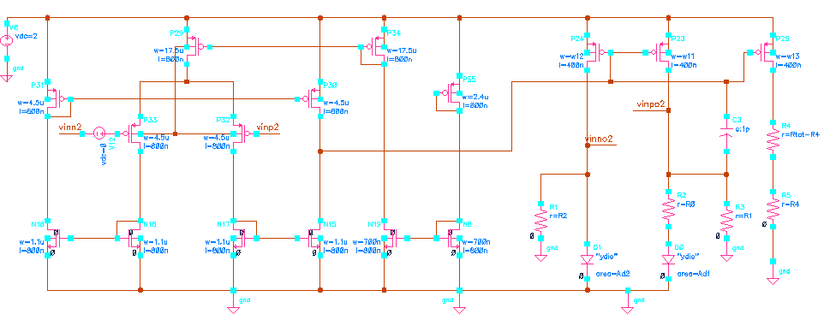
BG Circuit with simple bias circuit
No self biasing
No startup problem, no startup circuit needed
Amplifier current depends on power supply voltage

Slide 27
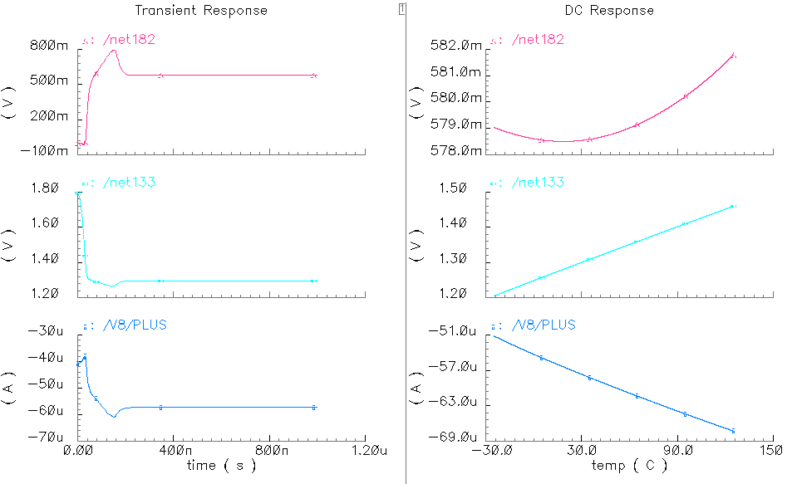

Slide 28
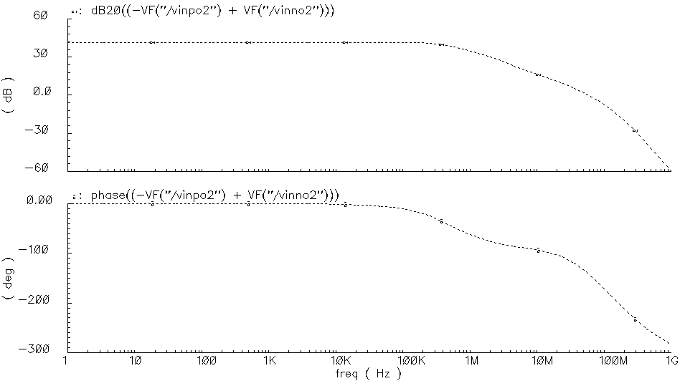
Loop gain simulation
Cc=0 F , Phase Margin = 37.86º

Slide 29
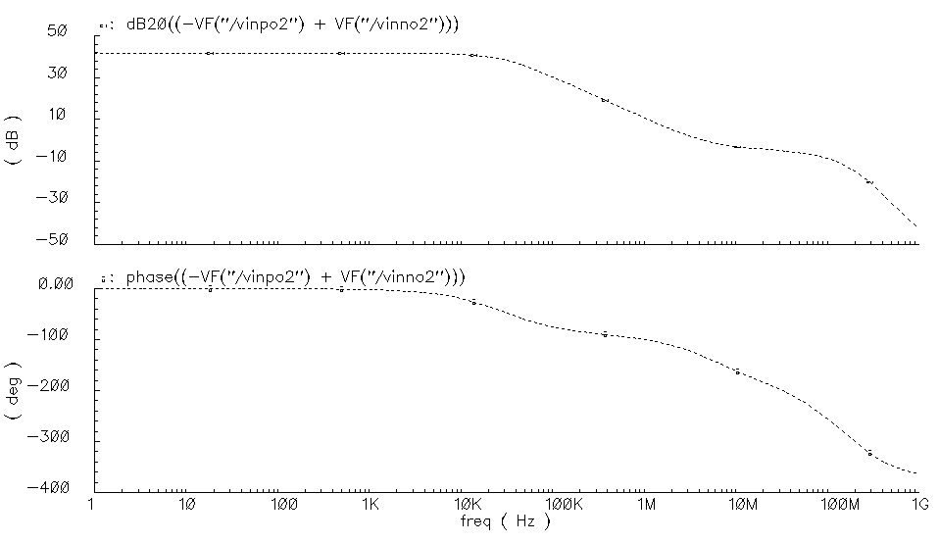
Phase Margin = 47.13º
Cc=1pF

Slide 30
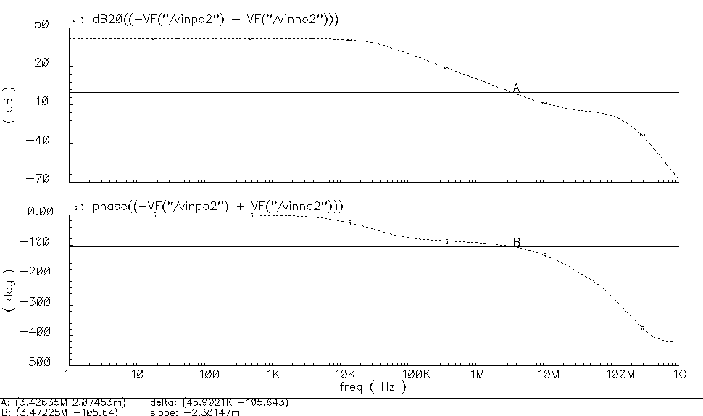
Cc+R compensation, 1pF+20kOhm
Phase Margin = 74.36º

Slide 31
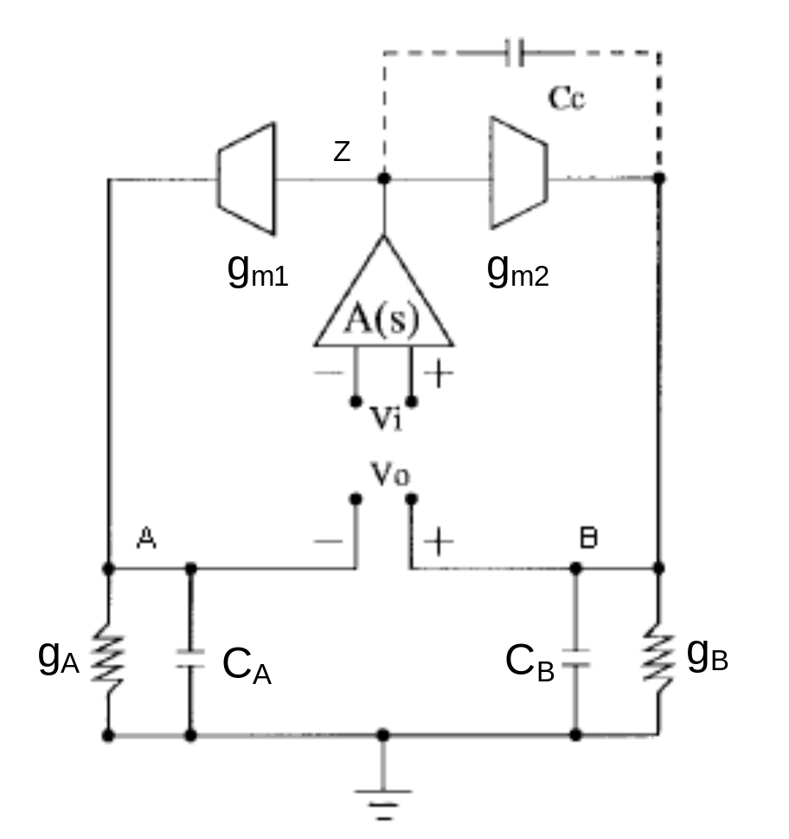
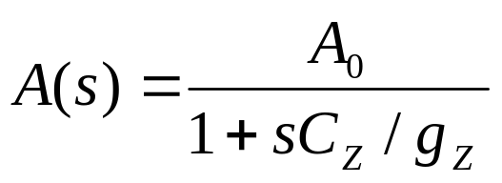
g_{A} is the total conductance of node A, and g_{A} = g_{o1}+g_{A}’,
g_{B} is the total conductance of node B, and g_{B} = g_{o2}+g_{B}’,
g_{Z} is the total conductance of node Z
C_{A}, C_{B} and C_{Z} are the total capacitance at nodes A, B and Z

Slide 32
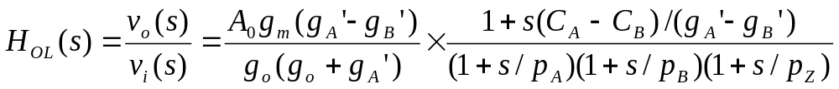
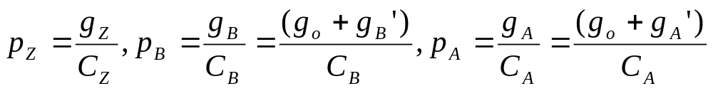
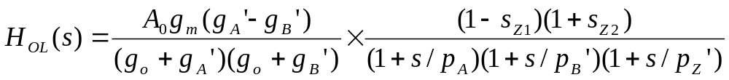
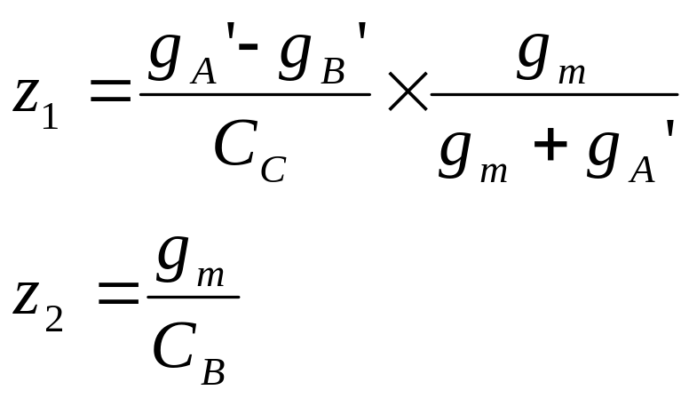
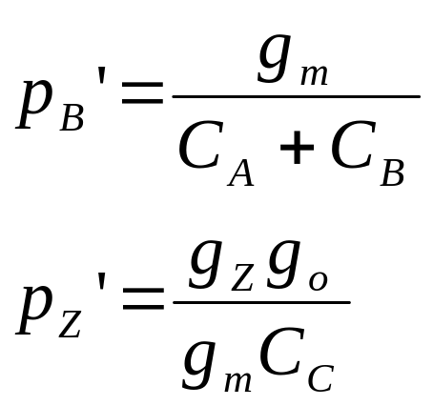
Then the open loop transfer function from V_{i+/-} to V_{o+/-} is
The transfer function with C_{C} in place is

Slide 33
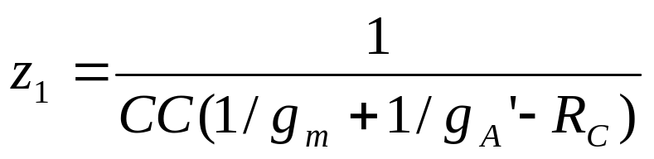
a nulling resistor R_{C} can be added in series with C_{C} to push z₁ to higher frequency

Slide 34
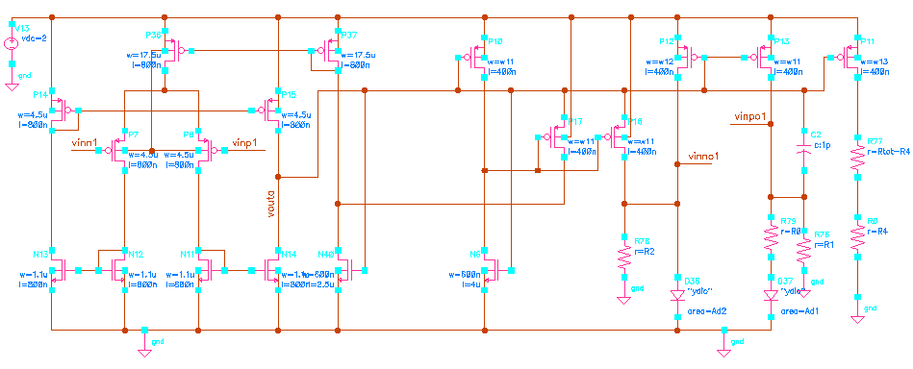
BG Circuit 3 with modified self-biasd circuit
Reduce one transistor in the self-biased loop to change the type of the feedback

Slide 35
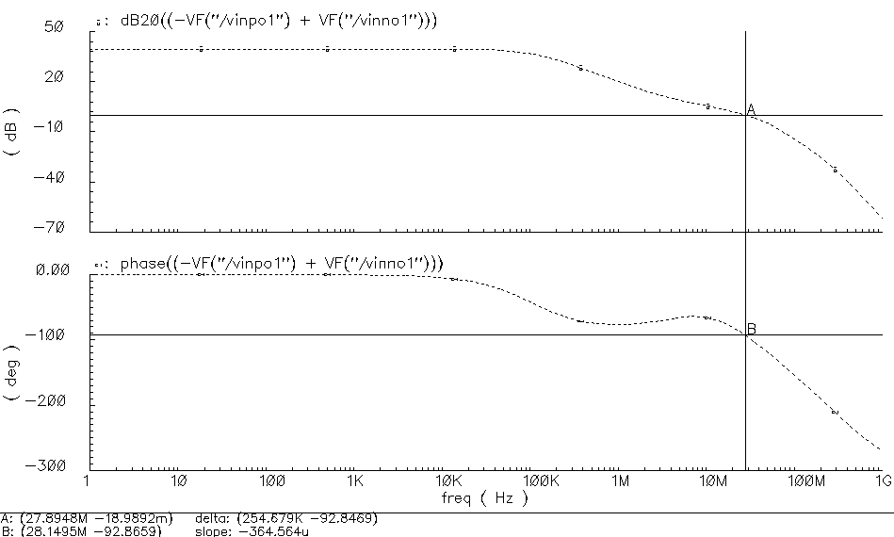
With Cc=0, Phase Margin = 87.13º

Slide 36
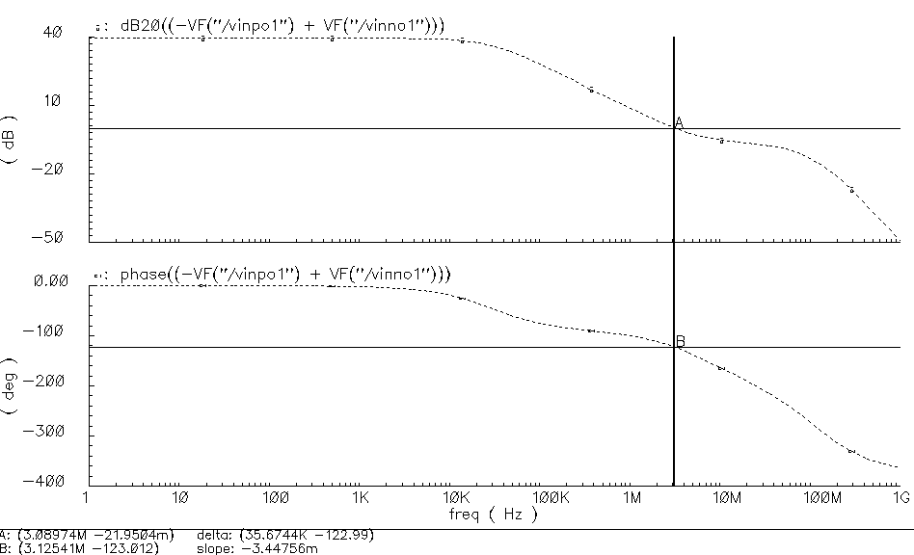
Cc=1 pF, Phase Margin = 56.99º
Lower bandwidth

Slide 37
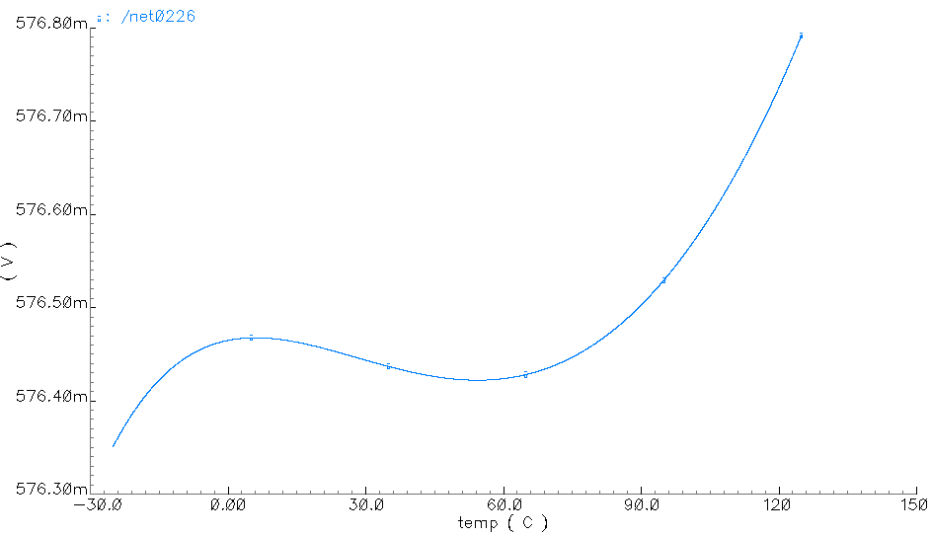
BG Simulation for different diode current
id=13uA

Slide 38
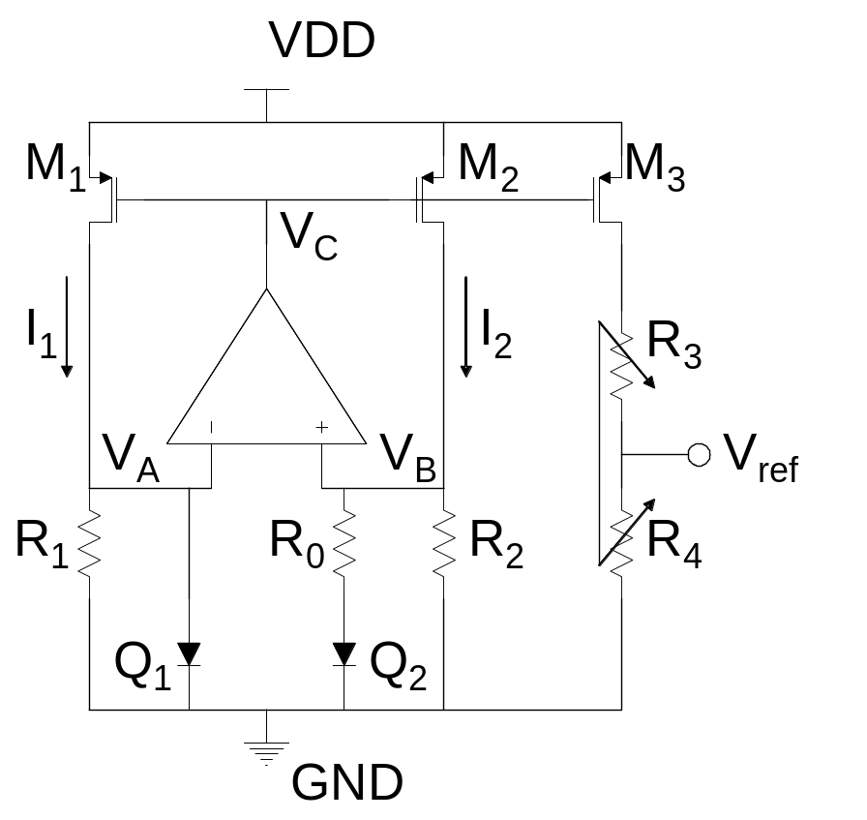
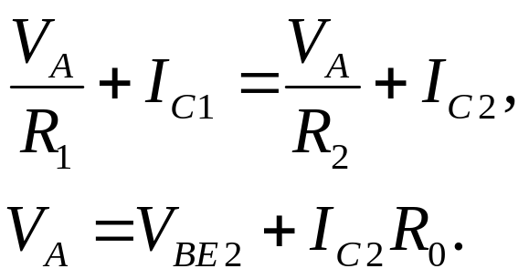
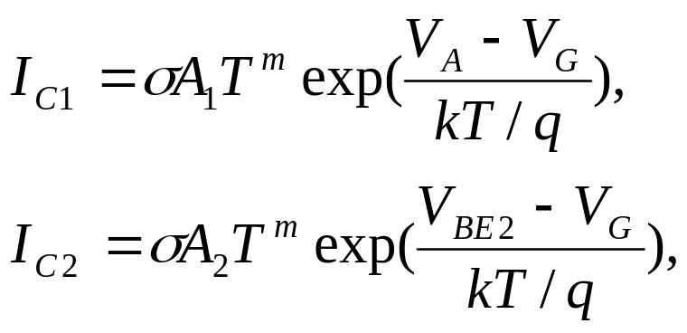
Characterization of a bandgap circuit
Assuming an ideal op amp with an infinite gain, we have V_{A} = V_{B} and I₁ = I₂.
Schematic of the current-mode bandgap circuit

Slide 39
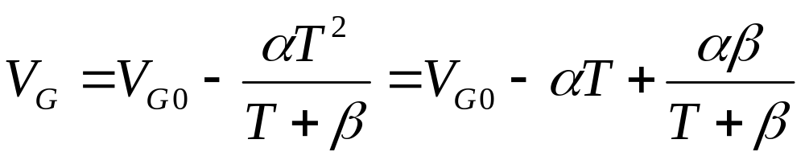
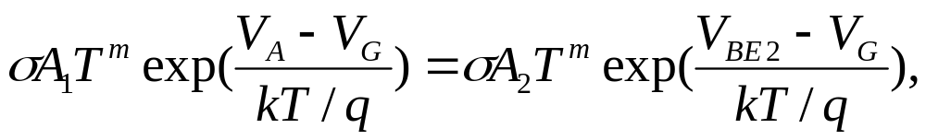
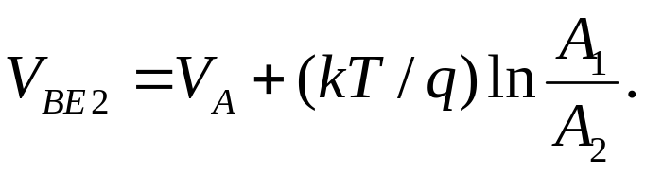
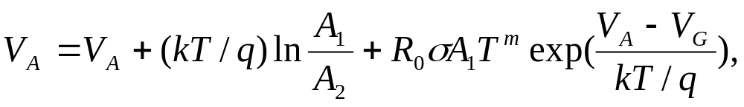
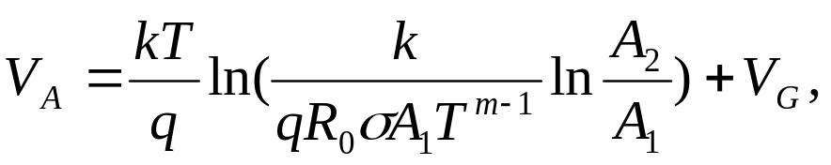
For the silicon, α=7.021×10⁻⁴V/K, β=1108K, V_{G}(0)=1.17V
Since R₁=R₂, we know I_{C1} = I_{C2}. Solving for V_{be2}:
➔
Substituting back
➔

Slide 40
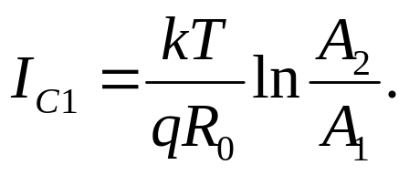

We know I₁=I_{C1}+V_{A}/R₁. That gives
Take partial derivative of I₁ with respect to temperature
For a given temperature, set the above to 0 and solve for R1. That tells you how to select R1 in terms of temperature, area ratio, and R0.
Other quantities are device or process parameters.

Slide 41


In most literature, the last two items are ignored, that allows solution of inflection temperature T0 in terms of R0, R1, area ratio:
The current at the inflection point is

Slide 42

Curvature and sensitivity
The second-order partial derivative of I₁ wrpt T is
Notice that under a specific temperature, the second-order derivative is inversely proportional to the resistance R₁. We would like to have small variation of I₁ around T_{INF}, so it is preferable to have a large R₁.

Slide 43




Denote the first derivative of I1 by
➔

Slide 44


The sensitivity of T_{INF} wrpt R₀ and R₁ are
For R₁ = 13.74 KOhm and R₀ = 1 KOhm, the sensitivity wrpt R₀ is about -6.75, and about 6.5 wrpt R₁, when A₂/A₁ is equal to 8.

Slide 45




Effects of mismatch errors and the finite op amp gain
First, suppose current mirror mismatch leads to mismatch between Ic1 and Ic2. In particular, suppose:
➔
Re-solve for V_{A}

Slide 46


Finally we get
the first line is I_{C1} and the second is V_{A}/R₁
The derivative of I₁ wrpt T becomes

Slide 47



Define similar to before:
we can calculate

Slide 48


The sensitivity of T_{INF} wrpt the current mismatch is
This sensitivity is larger than those wrpt the resistances.
That requires the current mismatch be controlled in an appropriate region so that the resistances can be used to effectively tune the temperature at the inflection point.
The sensitivity of T_{INF} wrpt the voltage difference is
which means the inflection point temperature is not very sensitive to the voltage difference.

Slide 49



Slide 51



Slide 52



Slide 53


Slide 54


Slide 55

Curvature corrected bandgap circuit
R₃= R₄
V_{ref}
Q₂
Q₁
R₂
R₁

Slide 56


V_{BE}
T
V_{ref}
T

Slide 57
Solution:
R₄= R₅
V_{ref}
I_{PTAT}↓
D₂
D₁
R₁
R₂
I_{PTAT}²
R₃

Slide 58

V_{ref}
V_{BE}
V_{PTAT}
V_{PTAT}²
T

Slide 59
Ex:
Suppose you have an I_{PTAT}² source characterized by I_{PTAT}² = αT², derive the conditions so that both first order and second order partial derivative of V_{ref} with respect to T are canceled at a given temperature T₀.
Suggest a circuit schematic that can be used to generated I_{PTAT}² current. You can use some of the circuit elements that we talked about earlier together with current mirrors/amplifiers to construct your circuit. Explain how your circuit work. If you found something in the literature, you can use/modify it but you should state so, give credit, and explain how the circuit works.

Slide 60
Characterization of a Current-Mode Bandgap Circuit Structure for High-Precision Reference Applications
Hanqing Xing, Le Jin, Degang Chen and Randall Geiger
Iowa State University
05/22/2006

Slide 61
Outline
Background on reference design
Introduction to our approach
Characterizing a multiple-segment reference circuit
Structure of reference system and curve transfer algorithm
Conclusion

Slide 62
Background on reference design(1)
References are widely used in electronic systems.
The thermal stability of the references plays a key role in the performance of many of these systems.
Basic idea behind commonly used “bandgap” voltage references is combining PTAT and CTAT sources to yield an approximately zero temperature coefficient (TC).

Slide 63
Background on reference design(2)
Linearly compensated bandgap references have a TC of about 20~50ppm/ºC over 100ºC. High order compensation can reduce TC to about 10~20ppm /ºC over 100ºC.
Unfortunately the best references available from industry no longer meet the performance requirements of emerging systems.
System Resolution | 12 bits | 14 bits | 16 bits
TC requirement on reference | 2.44ppm/ºC | 0.61ppm/ºC | 0.15ppm/ºC
Notes:
As the industry moves to SoC scale circuits where very low voltage operation is essential, there are no solutions on the horizon for providing even modest performance

Slide 64
Introduction to our approach(1)
“Envirostabilized references”
  The actual operating environment of the device is used to stabilize the reference subject to temperature change.
Multiple-segment references
  The basic bandgap circuit with linear compensation has a small TC near its inflection point but quite large TC at temperatures far from the inflection point.
  High resolution can be achieved only if the device always operates near the inflection point.
  Multiple reference segments with well distributed inflection points are used.

Slide 65

Introduction to our approach(2)
A three-segment voltage reference
# Curves | 3 | 4 | 6 | 9
TC (ppm/°C) | 0.8 | 0.4 | 0.2 | 0.1
Accuracy (Bits) | 13 | 14 | 15 | 16
Temperature range: -25°C~125°C

Slide 66




Characterization of a bandgap circuit (1)
Well known relationship between emitter current and V_{BE}:
For the silicon the values of the constants in (5) are, α=7.021×10-4V/K, β=1108K and V_{G}(0)=1.17V [2].
Schematic of the current-mode bandgap circuit

Slide 67
Characterization of a bandgap circuit (2)
The inflection point temperature
  The temperature at the inflection point, T_{INF}, will make the following partial derivative equal to zero.
  It is difficult to get a closed form solution of T_{INF}. Newton-Raphson method can be applied to find the local maxima of I₁ and the corresponding T_{INF} associated with different circuit parameters.

Slide 68

Characterization of a bandgap circuit (3)
The inflection point of V_{ref} as a function of R₀
Notes:
70dB and 80dB are the op amp gains in the bandgap circuit.
Offset in simulation is zero.

Slide 69

Characterization of a bandgap circuit (4)
Output voltage at the inflection point
With a fixed resistance ratio R₃/R₁, output voltage at the inflection point changes with the inflection point temperature.
Voltage level alignment is required.

Slide 70

Characterization of a bandgap circuit (5)
The reference voltage changing with temperature
Notes:
70dB and 80dB are the op amp gains in the bandgap circuit.
Offset in simulation is zero.

Slide 71

Characterization of a bandgap circuit (6)
Curvature of the linear compensated bandgap curve
There are only process parameters and temperature in the expression of the curvature.
The curvature can be well estimated although different circuit parameters are used.

Slide 72

Characterization of a bandgap circuit (7)
2nd derivative of the bandgap curve at different inflection point temperatures (emitter currents of Ckt1 and Ckt2 are 20uA and 50uA respectively and opamp gain is 80dB )
Notes:
Curvatures of current curves are the same as the analysis, but curvatures of voltage curves are not.

Slide 73
Structure of reference system and curve transfer algorithm (1)
Three major factors that make the design of a multi-segment voltage reference challenging
  the precise positioning of the inflection points
  the issue of aligning each segment with desired reference level and accuracy
  establishing a method for stepping from one segment to another at precisely the right temperature in a continuous way

Slide 74

Structure of reference system and curve transfer algorithm (2)
the precise positioning of the inflection points
  The inflection point can be easily moved by adjusting R₀
  Equivalent to choosing a proper temperature range for each segment.
  The same voltage level at two end points gives the correct reference curve.
  With the information of the curvature, a proper choice of the temperature range makes sure the segment is within desired accuracy window.

Slide 75
Structure of reference system and curve transfer algorithm(3)
aligning each segment with desired reference level and accuracy
  The reference level can be easily adjusted by choosing different values of R₃, which will not affect the inflection point.
  Comparison circuit with higher resolution is required to do the alignment.

Slide 76
Structure of reference system and curve transfer algorithm(4)
Algorithm for stepping from one segment to another at precisely the right temperature in a continuous way
  Determining the number of segments and the temperature range covered by each of them
  Recording all the critical temperatures that are end points of the segments
  Calibration done at those critical temperatures
  Stepping algorithm

Slide 77

Structure of reference system and curve transfer algorithm(5)
Stepping algorithm
  When temperature rises to a critical temperature T_{C} at first time, find correct R₀ and R₃ values for the segment used for next T_{R} degrees
  T_{R} is the temperature range covered by the new segment

Slide 78

Structure of reference system and curve transfer algorithm(6)
System diagram
Notes:
Comparison circuit required to choose a proper value for R0, which gives the same end-point voltage level.
Heater required to switch temperature between T_{C} and T_{C}+T_{R}
To indicate current temperature, a temperature sensor is necessary.

Slide 79
Conclusion
A new approach to design high resolution voltage reference
Explicit characterization of bandgap references
developed the system level architecture and algorithm

Slide 80


Slide 81
Heater: the dimension of the heater is quite small in comparison with that of the die. It is regarded as a point heat source. The shadow region is where the heater can effectively change the temperature of the die. BG Circuit and Temp Sensor are in the effective heating region.
BG Circuit 1: the whole bandgap circuit includes bandgap structure, current mirror and the amplifier. R0 and R4 are both DAC controlled.
BG Circuit 2: the backup BG reference circuit, the same structure as BG Circuit 1 but with only R4 DAC controlled.
Temp. Sensor: the temperature sensor, which can sense the temperature change instantaneously, is located close to the bandgap circuit and has the same distance to the heater as the bandgap circuit so that the temperature monitored represents the ambient temperature of the bandgap circuit. Need good temperature linearity.
ADC: quantize analog outputs of the temperature sensor. Need 10-bit linearity.
Control Block: state machine is used as a controller, which receives the temperature sensing results and the comparison results and gives out control signals for binary search and heater.
DAC Control for R0 and R4: provide the digital controls for R0 and R4 in bandgap structure.
Binary Search: implement binary search for choosing right control signal for R0 and R4.
Comparison Circuitry: compare the outputs of the bandgap outputs. It is capable of making a comparison differentially or single-ended between the bandgap outputs at two differential moments and two different temperatures. The comparison circuitry should be offset cancelled and have small enough comparison resolution (much higher than 16-bit).

Slide 82


Slide 83
Curve transfer algorithm
Prerequisites:
Calibrate the temperature sensor. The sensor needs to have good linearity. That means the outputs of the sensor is linear enough with the temperature. The ADC also needs good linearity for accurately indicating the temperature, 10-bit linearity for 0.1 degree C accuracy.
Get the basic characteristics of the bandgap curve, such as the temperature range covered by one curve under the desired accuracy requirement, and the number of curves needed. Assume the temperature range covered by one curve under 16-bit accuracy is T_{r}, and with T_{r} degrees’ temperature change the output of the sensor changes S_{r}.

Slide 84
Procedure:
Phase 1: Production test, which gives correct DAC codes D_{R00} and D_{R40} for R0’s and R4’s controls to achieve a bandgap curve with its inflection point at current room temperature T₀ and its output voltage right now equal to the desired reference voltage V₀.

Slide 85
Phase 2: At the temperature T₀, do the following to obtain R0 and R4 control codes of the next bandgap curve with higher inflection points D_{R0H} and D_{R4H}:
  Step 1: Record the current output of the temperature sensor, as S₀, then reset the control code for R0 (keep the code for R4) to the first code in binary search, the output of the bandgap circuit is V_{L}.
  Step 2: Activate the heater and monitor the output of the sensor, stop the heater when the output arrives S₁=S₀+2S_{r} (or a litter bit smaller), the current output of the bandgap circuit is V_{H} with the R0 code unchanged.
  Step 3: Compare V_{L} and V_{H} with the comparison circuitry, continue the binary search for R0 and set the new binary code according to the result of comparison. Wait until the output of the sensor back to S₀, then record the output code for the new code.
  Step 4: Repeat the three steps above until the binary search for R0 is done. The final code for R0 can generate a new bandgap curve with its inflection at T₀+T_{r}. Store the new R0 control code for future use, denoted as D_{R0H}.

Slide 86
  Step 5: Monitor the ambient temperature change using the temperature sensor. When the output of the sensor rises to S₀+1/2S_{r}, start comparing the two bandgap outputs with R0 control code equal to D_{R00} and D_{R0H} respectively. Another binary search is applied to obtain the new R4 control code D_{R4H}, which ensure the two outputs in comparison are very close to each other.
  Step 6: Monitor the output of the sensor, when it goes higher than S₀+1/2S_{r}, the new codes for R0 and R4 are used and the curve transfer is finished. Keep monitoring the temperature change, when the output of the sensor goes to S₀+S_{r} (that means the current temperature is right at the inflection of the current curve), all the operations in the phase 2 can be repeated to get the next pare of codes for higher temperature.

Slide 87
Phase 3: When the ambient temperature goes lower, heater algorithm does not work effectively. Another procedure is developed to transfer to the lower inflection point curves. Temperature lower than room temperature cannot be achieved intentionally. Therefore we can not predict control codes for the ideal next lower curve as what we do in higher temperature case. When the temperature goes to T₀-1/2T_{r}, in order to maintain the accuracy requirement we have to find another bandgap curve with inflection point lower than T₀, the best we can achieve is the curve with its inflection point right at T₀-1/2T_{r}. Thus for temperature range lower than initial room temperature T₀, we need curves with doubled density of curves in the higher temperature range.
  Step 1: At the initial time with room temperature T₀, record the bandgap output voltage V_{0a} and the current control code for R0 D_{R00}. Monitor the temperature, when it goes to S₀-1/2S_{r}, note the bandgap output V_{0b} and then reset the control code for R0 to the first code of binary search, D_{BS0}. Record the bandgap output V_{1a}.

Slide 88
  Step 2: Start heating. When the output of the sensor is back to S₀ record the bandgap output V_{1b}.
  Step 3: Do differential comparison between V_{0a}-V_{0b} and V_{1a}-V_{1b}.
  Step 4: Wait for the sensor output back to S₀-1/2S_{r}, change the R0 control code according to the comparison result. Record the bandgap output as V_{3a}.
  Step 5: Repeat step 2 to 4 until the binary search is done. The final control code for R0 D_{R0L} ensures the difference between V_{0a}-V_{0b} and V_{1a}-V_{1b} is very small and the inflection of the new bandgap curve is close to T₀-1/2T_{r}. Set R0 control code as D_{R0L}.
  Step 6: Activate the heater until the output of the sensor is S₀-1/4S_{r} and keep this temperature. Initial the binary search for R4. Compare the bandgap outputs of two curves with R0 control codes D_{R00} and D_{R0L} respectively. Set the R4 control code according to comparison results. The final code D_{R4L} is the new control code for R4, which ensures the two voltage in comparison are nearly equal.
  Step 7: Set D_{R0L} and D_{R4L} for R0 and R4 to finish the curve transfer. Keep monitoring the temperature change, when the output of the sensor goes to S₀-S_{r} (that means a new curve transfer needs to start), all the operations in the phase 3 can be repeated to get the next pare of codes for higher temperature.

Slide 89
Phase 4: Monitor the output of the temperature sensor. If a calibrated curve transfer is needed, set the new control codes for R0 and R4 according to the former calibration results. If a new calibration is needed, Phase 2 (temperature goes higher) or Phase 3 (temperature goes lower) is executed to obtain the new control codes.

Slide 90


Proposed Circuit

Slide 91



Multi-Segment Bandgap Circuit

Slide 92

Multi-Segment Bandgap Circuit
Observations
  T_{inf} is a function of R₀
  V_{inf} can be determined by R₄

Slide 93

Self-Calibration of Bandgap Circuit
Partition whole temperature range into small segments
Identify C₀, C₁ and C₂ as functions of R₀ through measurements
Use R₀ to set appropriate T_{inf} for each segment
Change R₄ to set the value of V_{inf}
Performance guaranteed by calibration after fabrication and packaging

Slide 94
Simulation Setup
TSMC 0.35 μm process
Cascoded current mirrors with W/L = 30 μm /0.4 μm
Diode junction area
  A₁ = 10 μm²
  A₂ = 80 μm²
R₁ = R₂ = 6 KΩ
R₃ + R₄ = 6 KΩ
2.5 V supply
Op amp in Veriloga with 70 dB DC gain

Slide 95


T_{inf}-R₀ Relationship
V_{ref} measurement
  R₀ ranging from 1150 to 1250 Ω with 1 W
  T = 20, 22, and 24 °C
  Measured voltage has accuracy of 1 μV
Top left: Actual and estimated T_{inf} as a function of R₀
Bottom left: Error in estimation

Slide 96

T_{inf}-R₀ Relationship

Slide 97

Multi-Segment Bandgap Curve
60-μV variation over 140 °C range gives 0.36 ppm/°C

Slide 98
Analysis of the Bandgap Reference Circuit

Slide 99

Schematic and Nodal Equations
Analytical solution w/o A and Vos
eq1='(VA-VC)/R1+ID1=0';
eq2='(VB-VC)/R2+ID2=0';
eq3='VA-VB=0';
eq4='ID2=(VB-VD)/R0';
eq5='ID1=Isx1*exp((VA-VG)/Vt)';
eq6='ID2=Isx2*exp((VD-VG)/Vt)';
S=solve(eq1, eq2, eq3, eq4, eq5, eq6, 'VA,VB,VC,VD,ID1,ID2');
VC=
VG
+log(log(Isx2*R2/Isx1/R1)*Vt*R2/R0/Isx1/R1)*Vt
-R2*log(Isx1*R1/Isx2/R2)*Vt/R0

Slide 100
Schematic and Nodal Equations
Derivative wrpt Vos: VA-VB=Vos
eq1='(pVA-pVC)/R1+pID1=0';
eq2='(pVB-pVC)/R2+pID2=0';
eq3='pVA-pVB=1';
eq4='pID2=(pVB-pVD)/R0';
eq5='pID1=ID1*pVA/Vt';
eq6='pID2=ID2*pVD/Vt';
SpVos=solve(eq1, eq2, eq3, eq4, eq5, eq6, 'pVA,pVB,pVC,pVD,pID1,pID2');
pVCpVos=
-(Vt+ID1*R1)*(ID2*R0+Vt+ID2*R2)
/(-Vt*R2*ID2+ID1*R0*R1*ID2+ID1*Vt*R1)

Slide 101
Schematic and Nodal Equations
Derivative wrpt to 1/A: VC*(1/A)=VA-VB
eq1='(pVA-pVC)/R1+pID1=0';
eq2='(pVB-pVC)/R2+pID2=0';
eq3='VC+pVC/A=pVA-pVB';
eq4='pID2=(pVB-pVD)/R0';
eq5='pID1=ID1*pVA/Vt';
eq6='pID2=ID2*pVD/Vt';
SpA=solve(eq1, eq2, eq3, eq4, eq5, eq6, 'pVA,pVB,pVC,pVD,pID1,pID2');
pVCpA=
-VC*A*(Vt^2+Vt*ID2*R0+Vt*R2*ID2
+ID1*Vt*R1+ID1*R0*R1*ID2+ID1*R1*ID2*R2)
/(Vt^2+Vt*ID2*R0-Vt*ID2*A*R2+Vt*R2*ID2
+ID1*A*R1*Vt+ID1*A*R1*ID2*R0
+ID1*Vt*R1+ID1*R0*R1*ID2+ID1*R1*ID2*R2)

Slide 102

Schematic and Nodal Equations
pVCpr1 =
ID1^2*R1*(ID2*R0+Vt+ID2*R2)
/(ID1*Vt*R1+ID1*R0*R1*ID2-R2*Vt*ID2)
pVCpr2 =
-ID2^2*R2*(Vt+ID1*R1)
/(-R2*Vt*ID2+ID1*Vt*R1+ID1*R0*R1*ID2);

Slide 103
Bandgap Reference Voltage
VC=
VG+log(log(Ar*R2/R1)*Vt*R2/R0/Isx1/R1)*Vt
+R2*log(Ar*R2/R1)*Vt/R0
+pVCpVos*Vos+pVCpA*(1/A)
+pVCpr1*r1+pVCpr2*r2

Slide 104
Approximation
pVCpVos =
-(Vt+ID1*R1)*(ID2*R0+Vt+ID2*R2)/(ID1*R0*R1*ID2)
pVCpA = VC*pVCpVos =
-VC*(Vt+ID1*R1)*(ID2*R0+Vt+ID2*R2)/(ID1*R1*ID2*R0)
pVCpr1 = ID1^2*R1*(ID2*R0+Vt+ID2*R2)/(ID1*R0*R1*ID2)
pVCpr2 = -ID2^2*R2*(Vt+ID1*R1)/(ID1*R0*R1*ID2)

Slide 105
Simplification
pVCpVos ~=
-(1+log(Ar*R2/R1)*R2/R0)*(1+log(Ar*R2/R1)+log(Ar*R2/R1)*R2 /R0)
/(log(Ar*R2/R1)^2*R2/R0)
pVCpA ~= -VC
*(1+log(Ar*R2/R1)*R2/R0)*(1+log(Ar*R2/R1)+log(Ar*R2/R1)*R2 /R0)
/(log(Ar*R2/R1)^2*R2/R0)
pVCpr1 ~= Vt*(1+log(Ar*R2/R1)+log(Ar*R2/R1)*R2/R0)*R2/R1/R0
pVCpr2 ~= -Vt*(1+log(Ar*R2/R1)*R2/R0)/R0

Slide 106
Comparison
pVCpVos ~=
-(1+log(Ar*R2/R1)*R2/R0)*(1+log(Ar*R2/R1)+log(Ar*R2/R1)*R2 /R0)
/(log(Ar*R2/R1)^2*R2/R0)
pVCpA ~= VC*pVCpVos
pVCpr1 ~= Vt*(1+log(Ar*R2/R1)+log(Ar*R2/R1)*R2/R0)*R2/R1/R0
pVCpr2 ~= -Vt*(1+log(Ar*R2/R1)*R2/R0)/R0
pVBEpT = k/q*(1-r)
+log(log(Ar*R2/R1)*k*T/q*R2/R1/R0/sigma/A1/(T^r))*k/q+pVGpT
= - log(Ar*R2/R1)*R2/R0*k/q @ Tinf
pPTATpT= log(Ar*R2/R1)*R2/R0*k/q
p^2VBEpT^2 = k/q/T*(1-r)+p^2VGpT^2 @ Tinf

Slide 107
Comparison
pVCpVos ~=
-(1+pPTATpT*q/k)*(R2/R0+pPTATpT*q/k+pPTATpT*q/k*R2/R0)
/(pPTATpT*q/k)^2
pVCpA ~= VC*pVCpVos
pVCpr1 ~= Vt*(R2/R0+pPTATpT*q/k+pPTATpT*q/k*R2/R0)/R1
pVCpr2 ~= -Vt*(1+pPTATpT*q/k)/R0
pVBEpT = k/q*(1-r)
+log(log(Ar*R2/R1)*k*T/q*R2/R1/R0/sigma/A1/(T^r))*k/q+pVGpT
= - log(Ar*R2/R1)*R2/R0*k/q @ Tinf
pPTATpT= log(Ar*R2/R1)*R2/R0*k/q
log(Ar*R2/R1)*R2/R0=pPTATpT*q/k
p^2VBEpT^2 = k/q/T*(1-r)+p^2VGpT^2 @ Tinf

Slide 108


Comparison

Slide 109

R0 = 1225 ohm, Vos = 0
T-independent Silicon Bandgap

Slide 110

R0 = 1109 ohm, Vos = 0
T-dependent Silicon Bandgap

Slide 111

R0 = 1109 ohm, Vos = 1 mV with no TC
T-dependent Silicon Bandgap

Slide 112

R0 = 1109 ohm, Vos = 1 mV with 1000 ppm TC
T-dependent Silicon Bandgap

Slide 113

R0 = 1100 ohm, Vos = 1 mV with 1000 ppm TC
T-dependent Silicon Bandgap

Slide 114
Vref = VG+log(log(Ar*R2/R1)*Vt*R2/R1/R0/Isx1)*Vt
+log(Ar*R2/R1)*Vt*R2/R0
VBE = VG + log(log(Ar*R2/R1)*Vt*R2/R1/R0/Isx1)*Vt
= VG + log(log(Ar*R2/R1)*(k*T/q)*R2/R1/R0/(sigma*A1*T^r))*(k*T/q)
PTAT = log(Ar*R2/R1)*R2/R0*k*T/q
pVBEpT = k/q*(1-r)
+log(log(Ar*R2/R1)*k*T/q*R2/R1/R0/sigma/A1/(T^r))*k/q+pVGpT
= - log(Ar*R2/R1)*R2/R0*k/q @ Tinf
pPTATpT= log(Ar*R2/R1)*R2/R0*k/q
p^2VBEpT^2 = k/q/T*(1-r)+p^2VGpT^2 @ Tinf

Slide 115
Simplification
pVCpr1 ~=
ID1^2*R1*(ID2*R0+Vt+ID2*R2)/(ID1*R0*R1*ID2)
= Vt*(1+log(Ar*R2/R1)+log(Ar*R2/R1)*R2/R0)*R2/R1/R0
pVCpr2 ~= -Vt(1+log(Ar*R2/R1)*R2/R0)/R0
ID1=log(Ar*R2/R1)*Vt*R2/R1/R0
ID2=log(Ar*R2/R1)*Vt/R0

